Slide 1
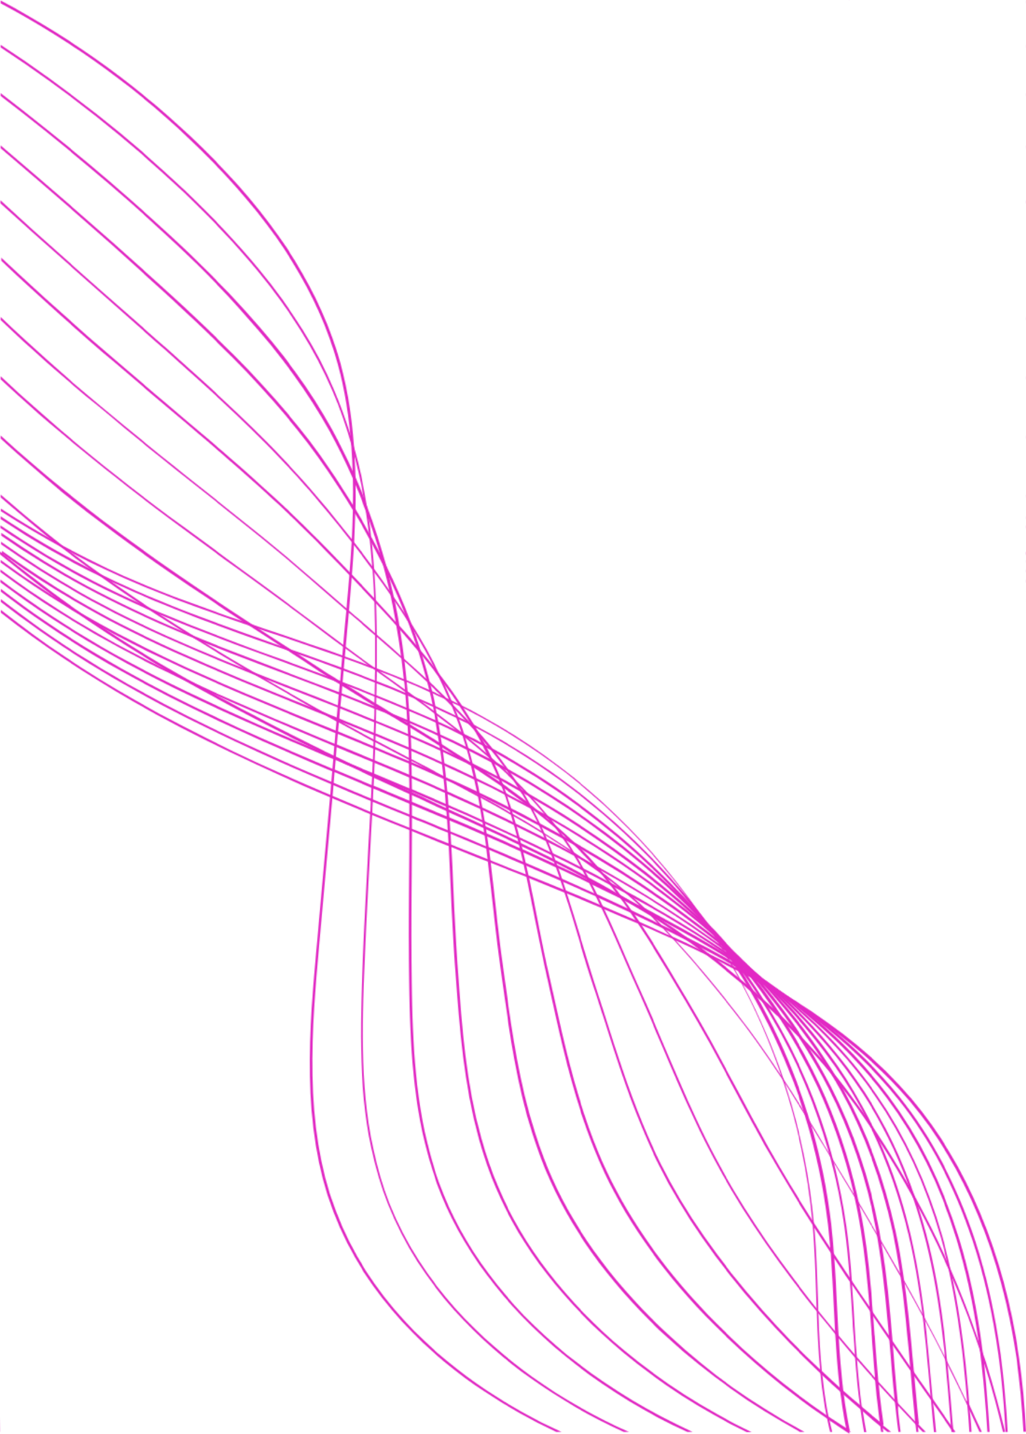
TEAM 4
Shimaa Shehata mohamed Shehata
Nourhan mohamed
Verina Erian
Farah Sayed

Slide 2
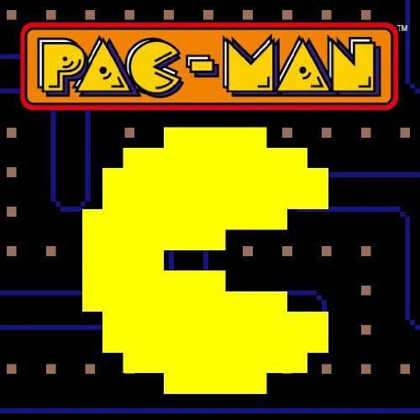
PAC-MAN

Slide 3
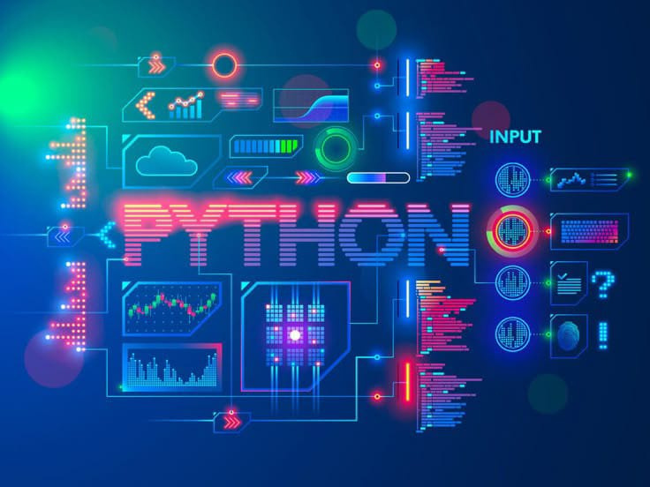
Introduction to PYTHON :
What is Python? Python is a programming language widely used in network applications, software development, data science, and machine learning (ML). Developers use Python because it is efficient, easy to learn, and can run on many different platforms. Python is available for free download and integrates well with all types of systems and increases development speed

Slide 4
Game
Organization
Key Features of Code:
Game Structure: The game is structured with classes for ghosts and functions for handling player movement, drawing the game board, and checking collisions.
Graphics and Sound: You've integrated images for the player and ghosts, as well as sound effects for various game events.
Game Logic: The game includes logic for power-ups, ghost behavior, and player lives.
Level Design: The game uses a 2D list to represent the game board, allowing for easy modifications to the level layout.

Slide 5
COMPONENTS:
Pacman
Ghosts
Grains
Sound
Board

Slide 6
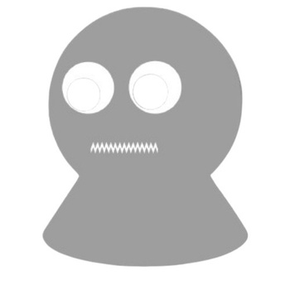
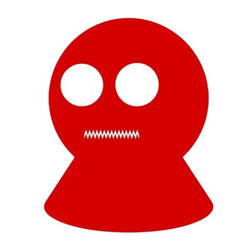
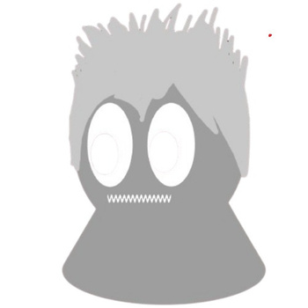
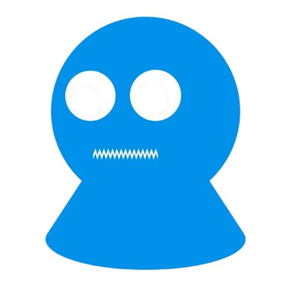
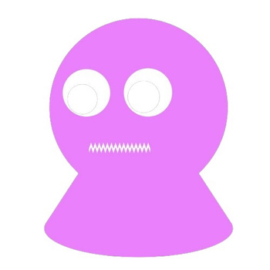
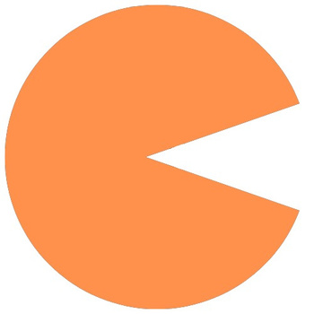
COMPONENTS:

Slide 7
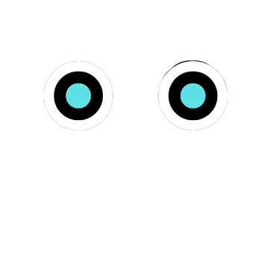
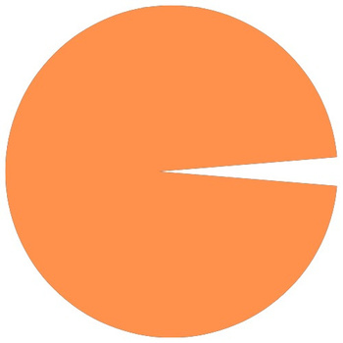
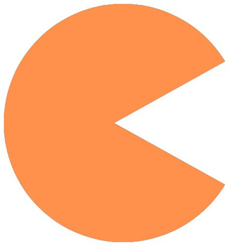
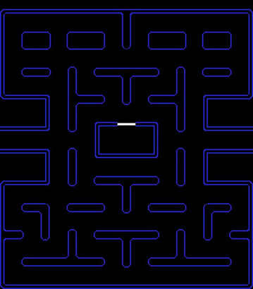
COMPONENTS:

Slide 8
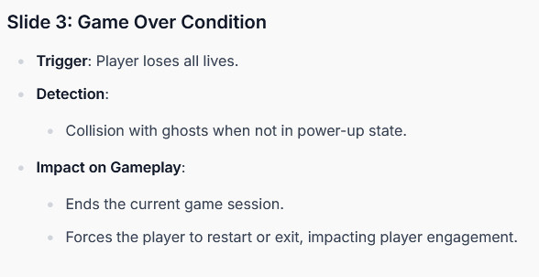
CODING

Slide 9
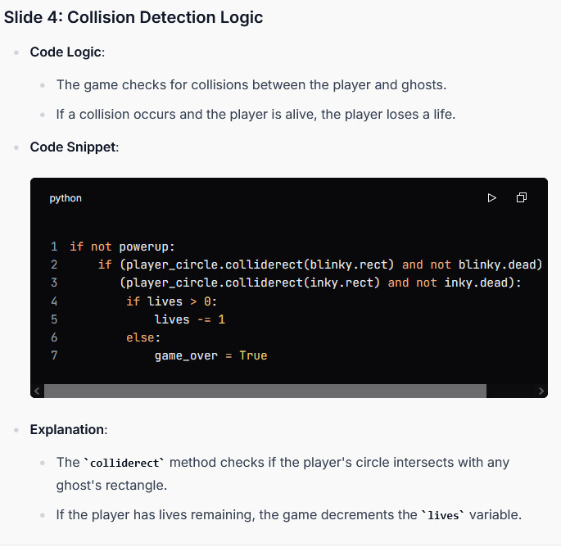

Slide 10
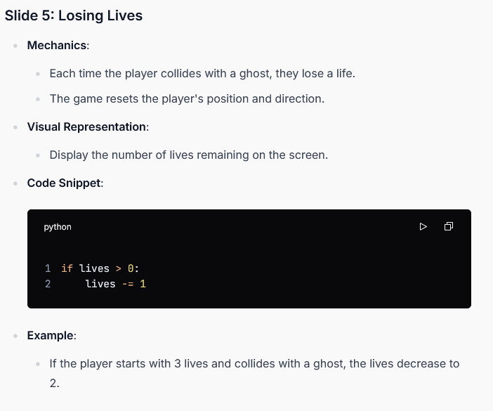

Slide 11
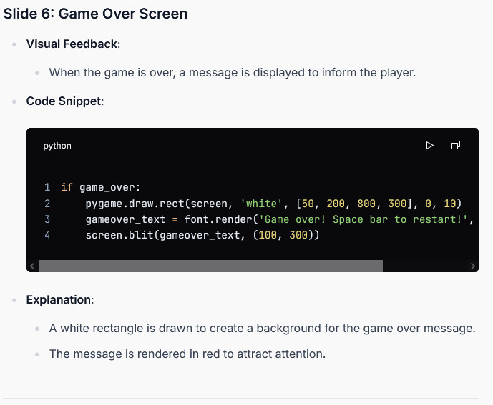

Slide 12
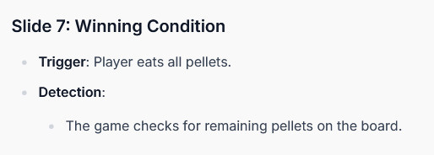

Slide 13
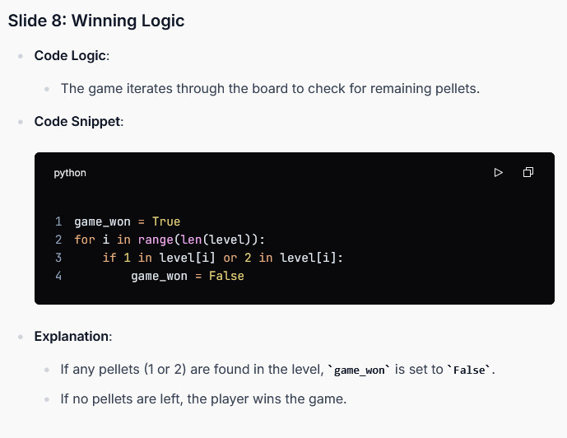

Slide 14
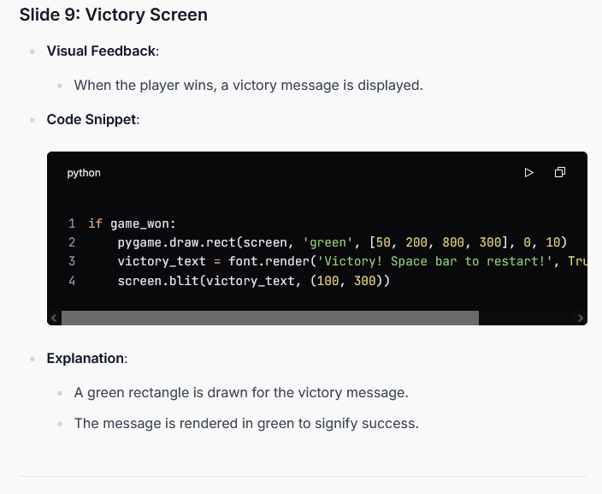

Slide 15
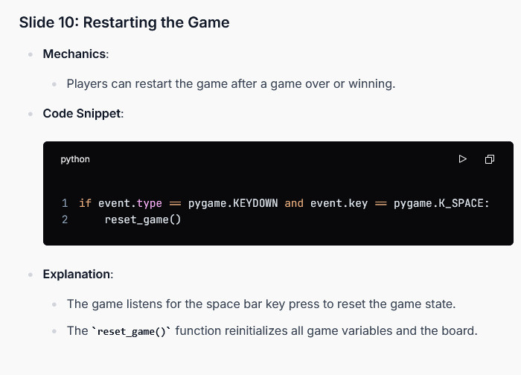

Slide 16
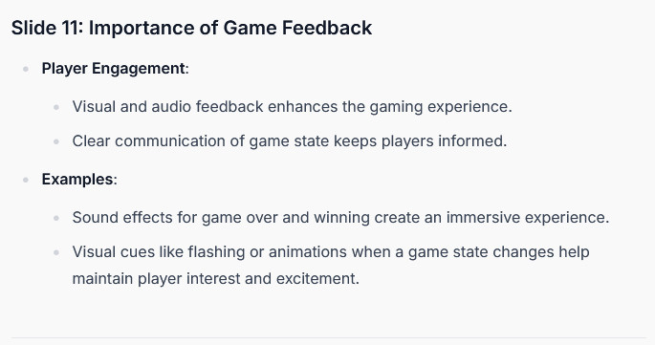

Slide 17
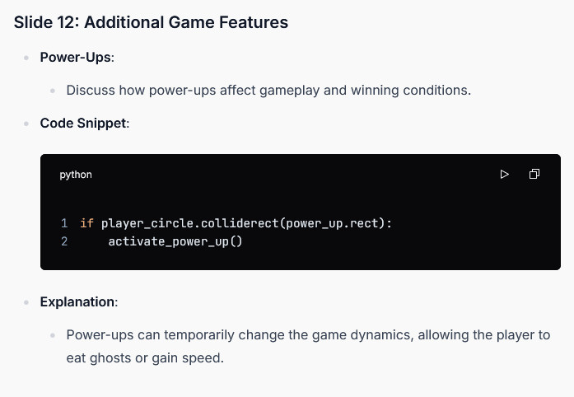

Slide 18
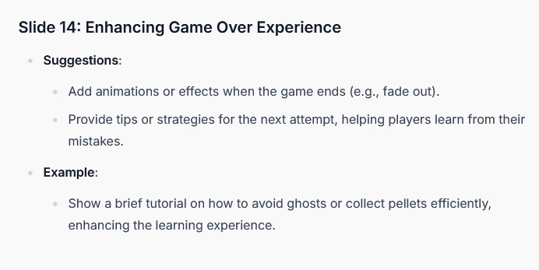

Slide 19
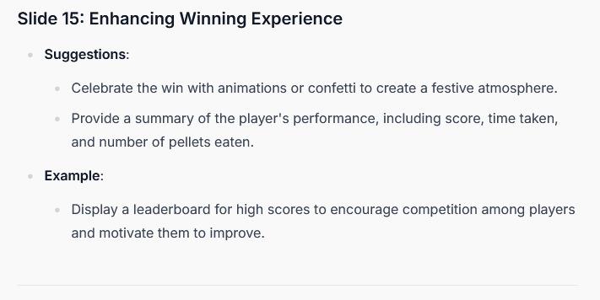

Slide 20
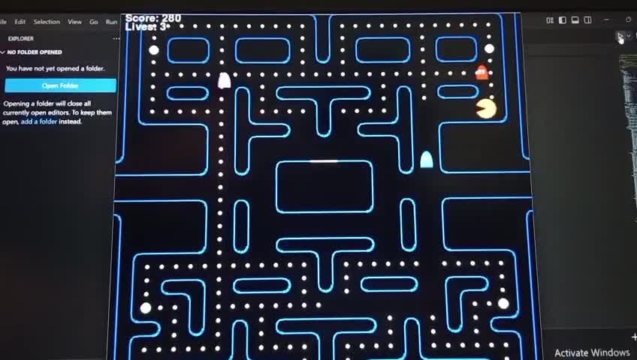

Slide 21
PAYTHON
Applications
Through the Python language, you can accomplish many tasks to support many fields, the most important of which are:
Web Development
Desktop Applications
Bot Systems
Data Analysis
Artificial Intelligence
Machine Learning
Deep Learning
Game Development

Slide 22
Conclusion
It should be noted that it cannot be said that a specific editor or development environment is better than another for developing Python projects, as the options are as many as the different needs of users, and the focus should be on the option that solves the problem facing the user or chooses the one that suits his experience. For beginners, choosing an integrated development environment or a simple, small-sized text editor is better, but if the user wants an editor that helps him write clearer code with fewer errors, choosing an advanced editor rich in features will help him achieve his goal

